Slide 1
WEATHER FORECAST
MADAGASCAR

Slide 2
SATELLITE IMAGE

Slide 3
SYNOPTIC CHART

Slide 4
UM 12 KM - ANALYSIS

Slide 5
SURFACE WIND

Slide 6
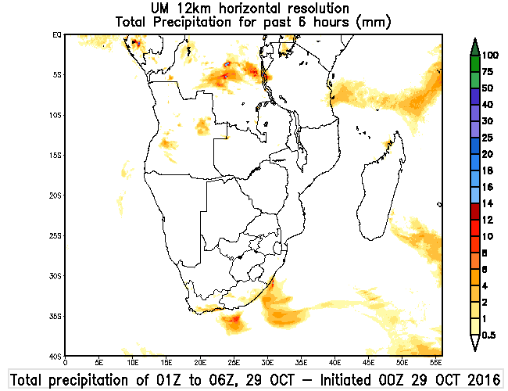
UM 12KM-PRECIPITATION

Slide 7
UM4KM-PRECIPITATION

Slide 8
EFI

Slide 9
UM4-TEMPERATURE

Slide 10
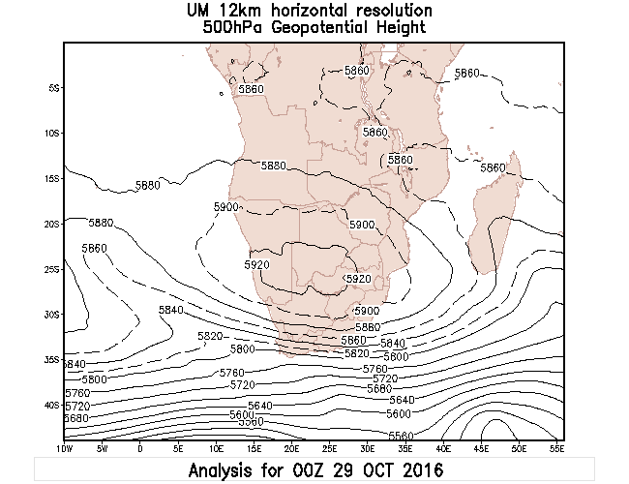
UPPER AIR

Slide 11
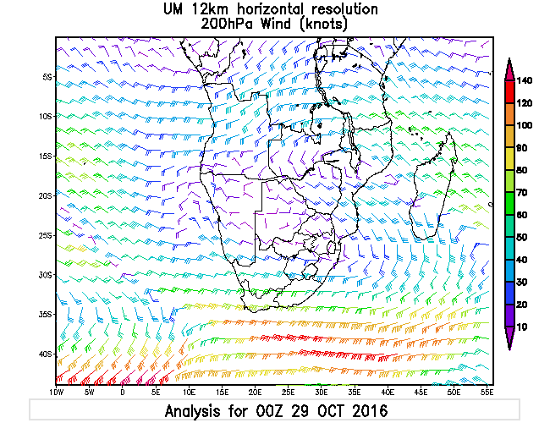
UPPER AIR WIND

Slide 12
CONCLUSIONS
SITUATION: MADAGASCAR LIES IN A COL AREA – LIGHT WIND
NO EXTREME WEATHER EXPECTED AT LARGE SCALE 1-2 DAYS
FEW SHOWERS 4-6MM/6HR EXPECTED OVER NORTHERN MADAGASCAR, REST MAINLY DRY USING SA12.
USING SA4, >50MM IS INDICATED IN THE NORTHERN PART BETWEEN 15Z-18Z
WARMER IN WEST COAST

